Slide 1


Aerospace Control System - Final Project
Estimation and Learning in Aerospace- Final Project
Milan, April 2024
Milan, 15 February 2024
Marzorati Emanuele
Smurra Tiberio Antonio

Slide 2
Presentation of the project
The project considers the dynamics of multirotor UAV and is characterized by the following two tasks​
​
Task I​
System Identification of longitudinal dynamics from simulated data for a given input​
​
Task II​
Robust Optimization of experiment design to maximise model accuracy
Notes:
L’obiettivo di questo progetto è di costruire e analizzare la robustezza e la stabilità del sistema di controllo di un drone, in particolare l’ANT-X. Considerando la dinamica su un singolo asse.

Slide 3
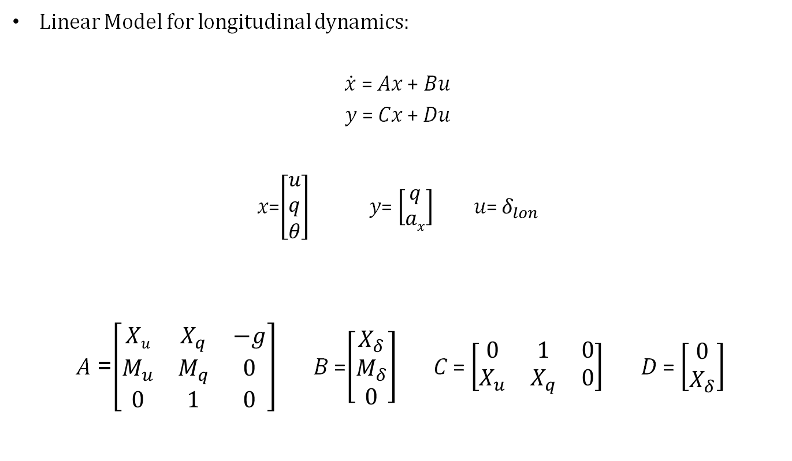
Problem Statement
Linear Model for longitudinal dynamics:
$\dot{x}$ = 𝐴𝑥 + 𝐵𝑢
𝑦 = 𝐶𝑥 + 𝐷𝑢
𝑥=$\left[\begin{aligned}u \\ q \\ θ\end{aligned}\right]$ 𝑦= $\left[\begin{matrix}q \\ ax\end{matrix}\right]$ 𝑢= $δ_{lon}$
𝐴 =$\left[\begin{matrix}Xu & X_{q} & −g \\ M_{u} & M_{q} & 0 \\ 0 & 1 & 0\end{matrix}\right]$𝐵 =$\left[\begin{matrix}X_{δ} \\ M_{δ} \\ 0\end{matrix}\right]$𝐶 = $\left[\begin{matrix}0 & 1 & 0 \\ X_{u} & X_{q} & 0\end{matrix}\right]$𝐷 = $\left[\begin{matrix}0 \\ X_{δ}\end{matrix}\right]$

Slide 4
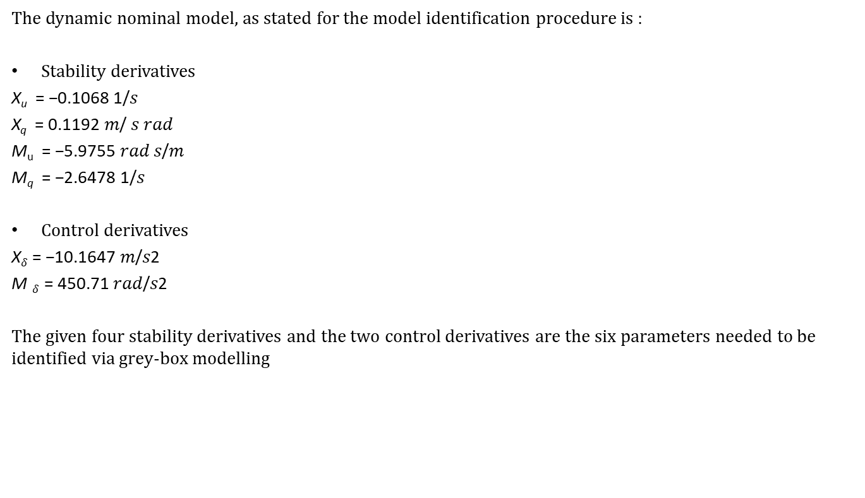
Data
The dynamic nominal model, as stated for the model identification procedure is :
Stability derivatives
X_{u} = −0.1068 1/𝑠
X_{q} = 0.1192 𝑚/ 𝑠 𝑟𝑎𝑑
M_{u} = −5.9755 𝑟𝑎𝑑 𝑠/𝑚
M_{q} = −2.6478 1/𝑠
Control derivatives
X$δ$= −10.1647 𝑚/𝑠2
M $δ$ = 450.71 𝑟𝑎𝑑/𝑠2
The given four stability derivatives and the two control derivatives are the six parameters needed to be identified via grey-box modelling

Slide 5
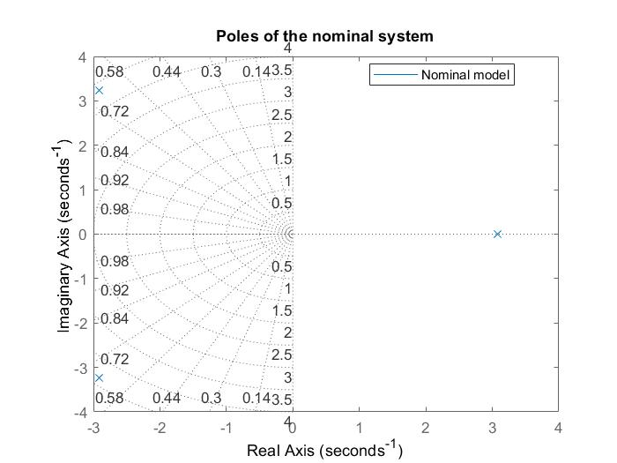
Open Loop System - Poles
Poles: -2,9195 ± 3,2375 i ; 3,0844
It can be noted that the system is not stable in open loop dynamics

Slide 6
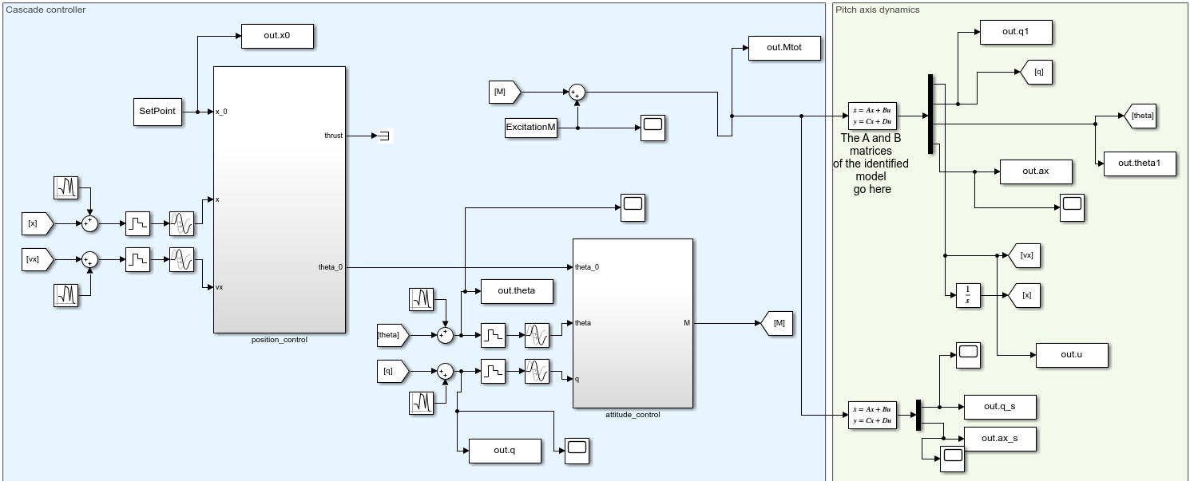
Simulink Model
Notes:
Remember to talk about the two scopes

Slide 7
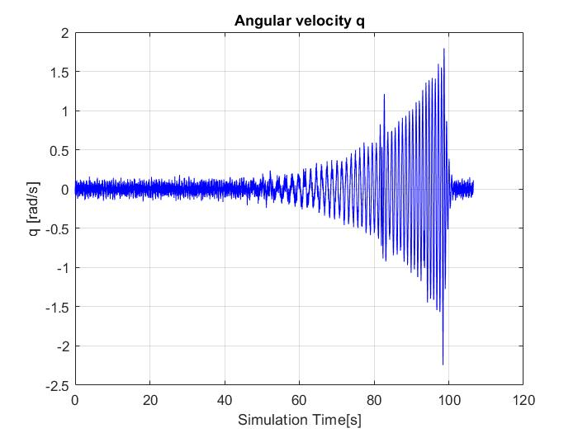
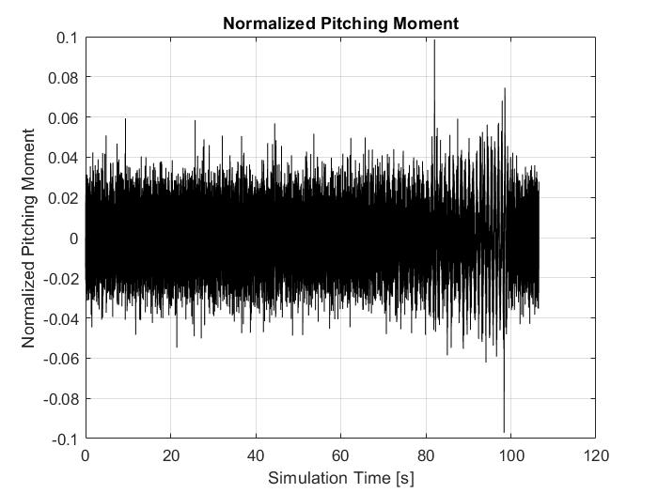
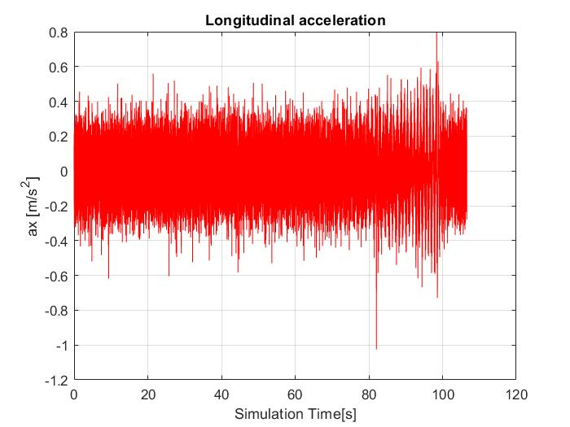
Task 1: Input and Output of the simulink model
The angular velocity and the longitudinal acceleration in time are the output of a simulink model, while the normalized pitching moment is the input given to the system.
The objective of the task one is to retreive the model parameters starting from this data.

Slide 8
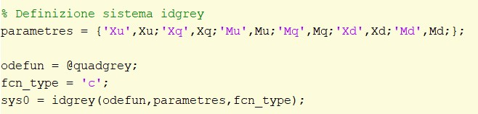
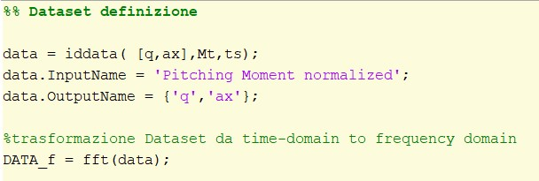
Task 1: Model Identification
In the approach of this task two outputs are being taken into account, and the output q is being measured before the dynamics of the system.
Because the open loop dynamics of the system is unstable it is necessary to perform the output error method in frequency domain.
First the idgrey system is created :
Data is being handled using the matlab function iddata :
Notes:
Come back to simulink model slide in order to show what we mean with this

Slide 9
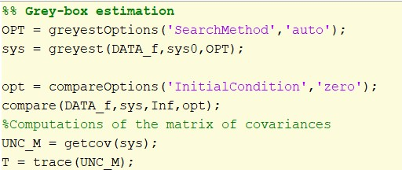
Task 1: Model Identification
It is then performed a grey-box estimation using the function greyest
Fit to estimation data: [94.88; 99.93]%
MSE: 0.0003119
Sum of Variances: 0.0257
 | X_{u} | X_{q} | M_{u} | M_{q} | X_{d} | M_{d}
VALUES Θ | -0.1067 | 0.1192 | -5.9856 | -2.6463 | -10.1647 | 450.9085
VAR s | 1.5412e(-08) | 1.9452e(-09) | 2.2227e(-04) | 6.7818e(-06) | 6.5983e(-10) | 0.0255
VAR % | 1.4450e(-05) | 1.6332e(-06) | 0.0037 | 2.5607e(-04) | 6.5071e(-09) | 0.0057
Outpuf of the identification
procedure:

Slide 10
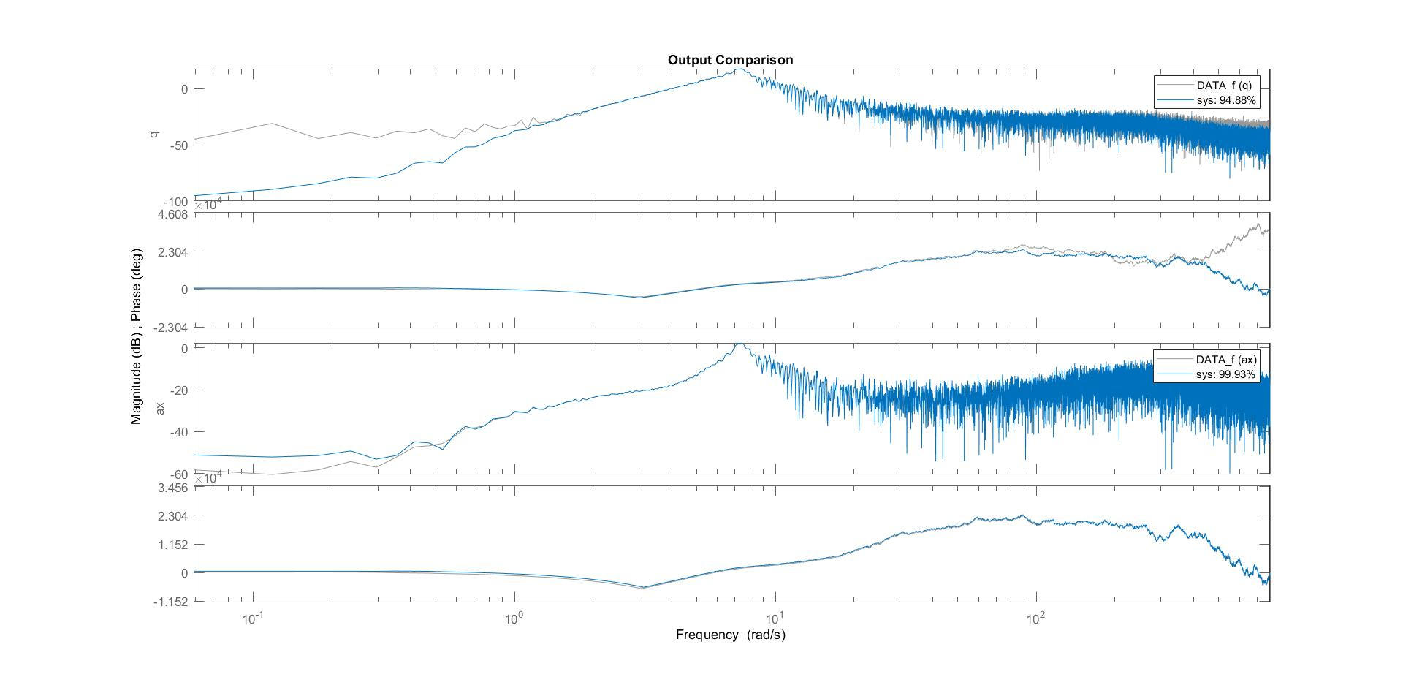
Task 1: Model Identification
Output comparison in frequency domain.

Slide 11
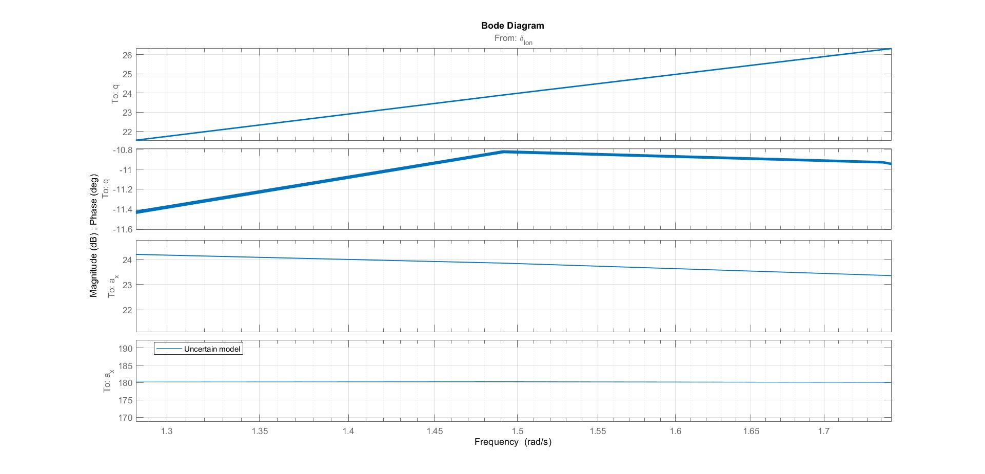
Task 1: Uncertainty Analysis
Bode diagram of the uncertain model(zoomed)
Notes:
Probably delete this slide

Slide 12
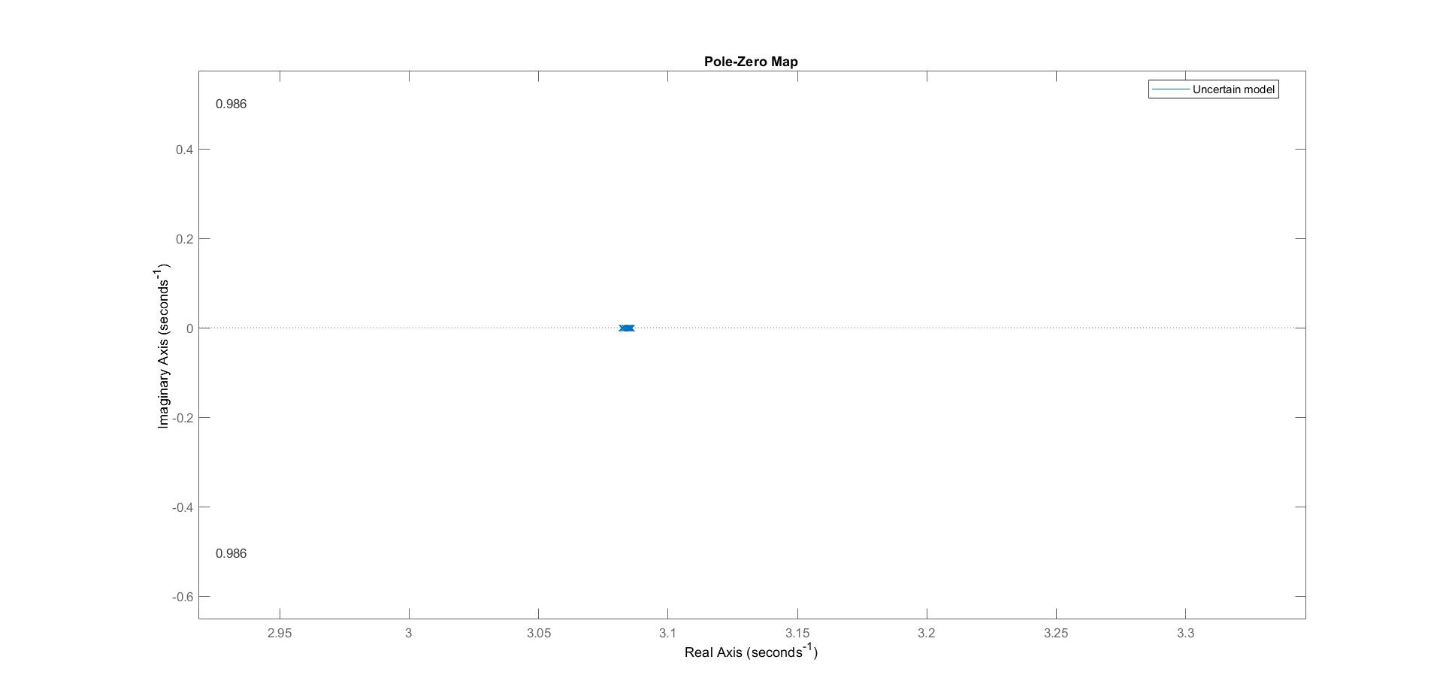
Task 1: Uncertainty Analysis
Zoom on the unstable pole in the uncertain model.

Slide 13
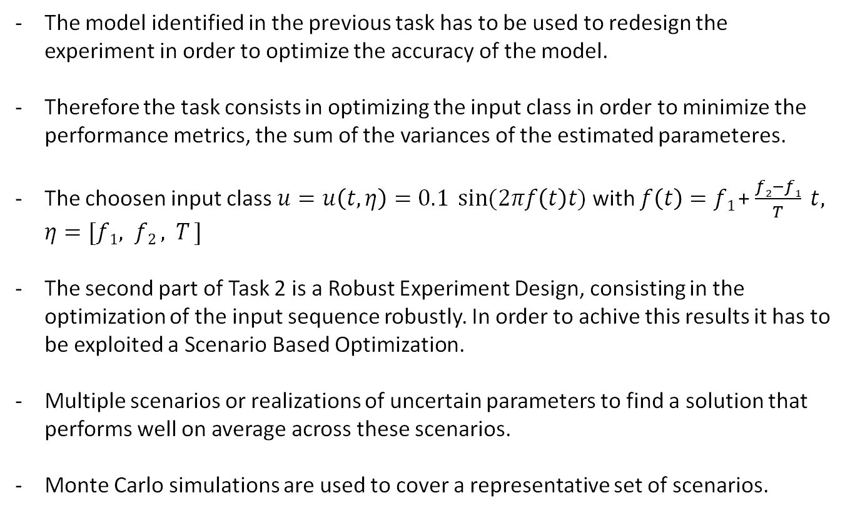
Task 2: Presentation
The model identified in the previous task has to be used to redesign the experiment in order to optimize the accuracy of the model.
Therefore the task consists in optimizing the input class in order to minimize the performance metrics, the sum of the variances of the estimated parameteres.
The choosen input class $u=u\left(t, η\right)=0.1 \sin{(2πf\left(t\right)t)}$ with $f\left(t\right)=f1$+ $\frac{f2−f1}{T} t, η=[f1, f2 , T ]$
The second part of Task 2 is a Robust Experiment Design, consisting in the optimization of the input sequence robustly. In order to achive this results it has to be exploited a Scenario Based Optimization.
Multiple scenarios or realizations of uncertain parameters to find a solution that performs well on average across these scenarios.
Monte Carlo simulations are used to cover a representative set of scenarios.

Slide 14
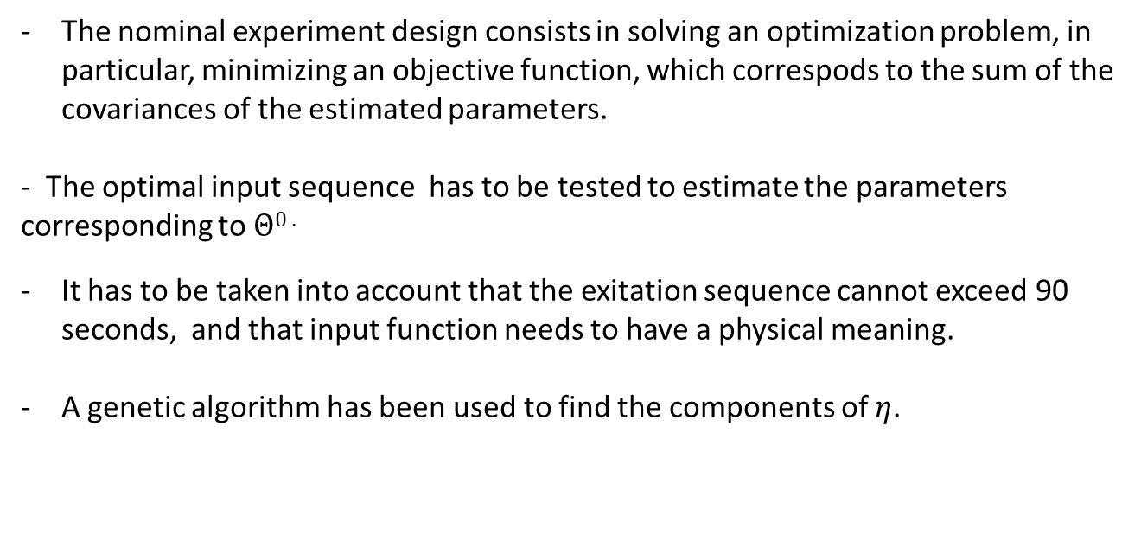
Task 2: Optimization of Experiment Design
The nominal experiment design consists in solving an optimization problem, in particular, minimizing an objective function, which correspods to the sum of the covariances of the estimated parameters.
- The optimal input sequence has to be tested to estimate the parameters corresponding to $Θ0$.
It has to be taken into account that the exitation sequence cannot exceed 90 seconds, and that input function needs to have a physical meaning.
A genetic algorithm has been used to find the components of $η$.

Slide 15
Task 2: Introduction to Genetic Algorithm
A genetic algorithm (GA) is a method for solving both constrained and unconstrained optimization problems based on a natural selection process that mimics biological evolution.
“ a powerful stochastic search algorithm based on mechanisms of natural genetics and selection” (Goldberg 1989)
The algorithm repeatedly modifies a population of individual solutions.
At each step, the genetic algorithm randomly selects individuals from the current population and uses them as parents to produce the children for the next generation.
A fitness function is used to give a score to the fitness level of each algorithm
Over successive generations, the population "evolves" toward an optimal solution.
It is possible to apply the genetic algorithm to solve problems that are not well suited for standard optimization algorithms, including problems in which the objective function is discontinuous, nondifferentiable, stochastic, or highly nonlinear.

Slide 16
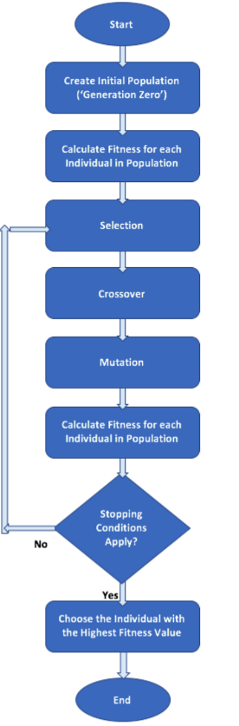
Task 2: Introduction to Genetic Algorithm
Start
Stopping conditions apply?
Create Initial Population
YES
Calculate Fitness Level of each individual
NO
Selection
Calculate Fitness for each Individual in population
Choosing Individuals with higher fitness value
Crossover
Mutation
End

Slide 17
Task 2 : Introduction to Genetic Algorithm
Classical Algorithm | Genetic Algorithm
Generates a single point at each iteration. The sequence of points approaches an optimal solution. | Generates a population of points at each iteration. The best point in the population approaches an optimal solution.
Selects the next point in the sequence by a deterministic computation. | Selects the next population by computation which uses random number generators.
Typically converges quickly to a local solution. | Typically takes many function evaluations to converge. May or may not converge to a local or global minimum.

Slide 18
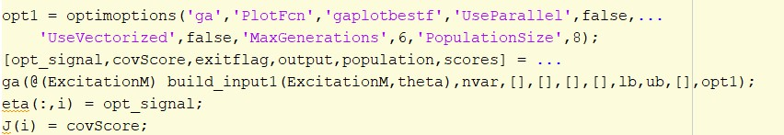
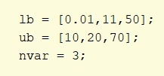
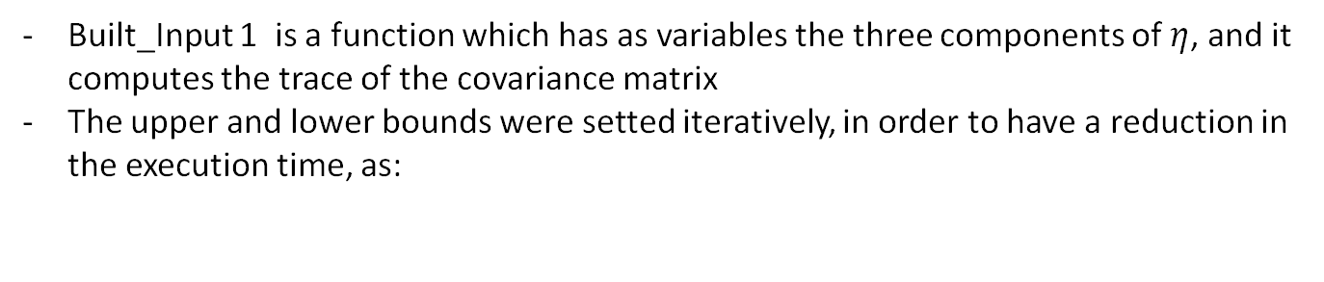
Task 2 : Introduction to Genetic Algorithm
Matlab Implementation
Built_Input 1 is a function which has as variables the three components of $η$, and it computes the trace of the covariance matrix
The upper and lower bounds were setted iteratively, in order to have a reduction in the execution time, as:

Slide 19
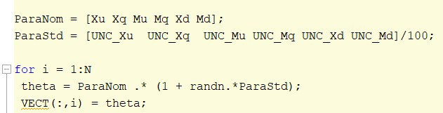
Task 2: Robust Experiment Design
The following steps are used in order to implement a robust experiment design:
From the identified model in task 1, using the computed uncertainties, N random models are generated
N nominal experiment design problems are solved, in order to find an input sequence and an optimal cost for each scenario

Slide 20
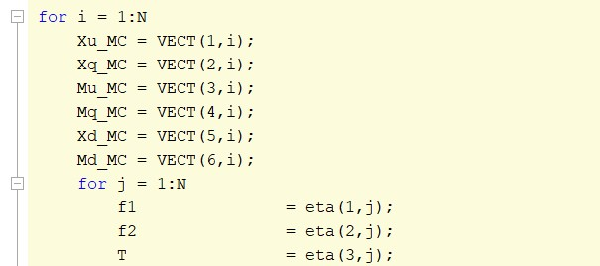
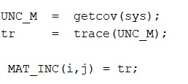
Task 2: Robust Experiment Design
3. Evaluation of each scenario against all scenarios:
The main result of this process is the computation of the matrix containing all the traces:

Slide 21
Task 2: Robust Experiment Design
4. Construction of optimal input sequencies
Once the two cycles have been processed, it’s necessary to search the 2 input sequencies which provide:
a) The best average performances
b) Best worst case performances
So taken the Matrix of traces, which has as row the N uncertainties system and as column the corresponding N optimal input, firstly the medium value of each column is computed. After the maximum value of each column is searched.
These calculations are made easily with the matlab’s command mean() and max().
In our case the input sequence which satisfies the case (a) and (b) is the same for both of them, this is due to several reasons linked to the not too big number of uncertainty system, the fact the minimum is not sure an absolute one ( computational reasons), the low uncertainty of the parameter of the system.

Slide 22
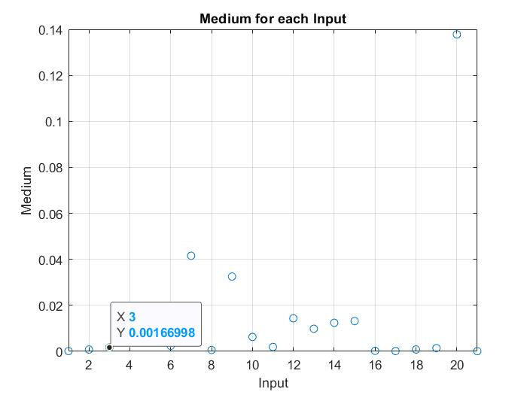
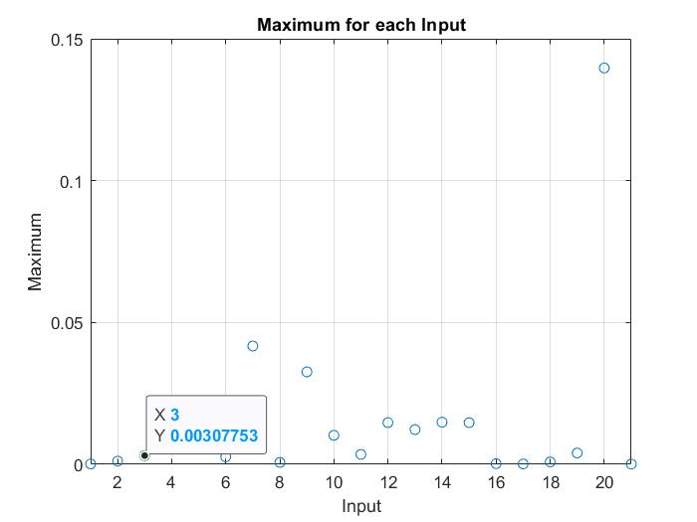
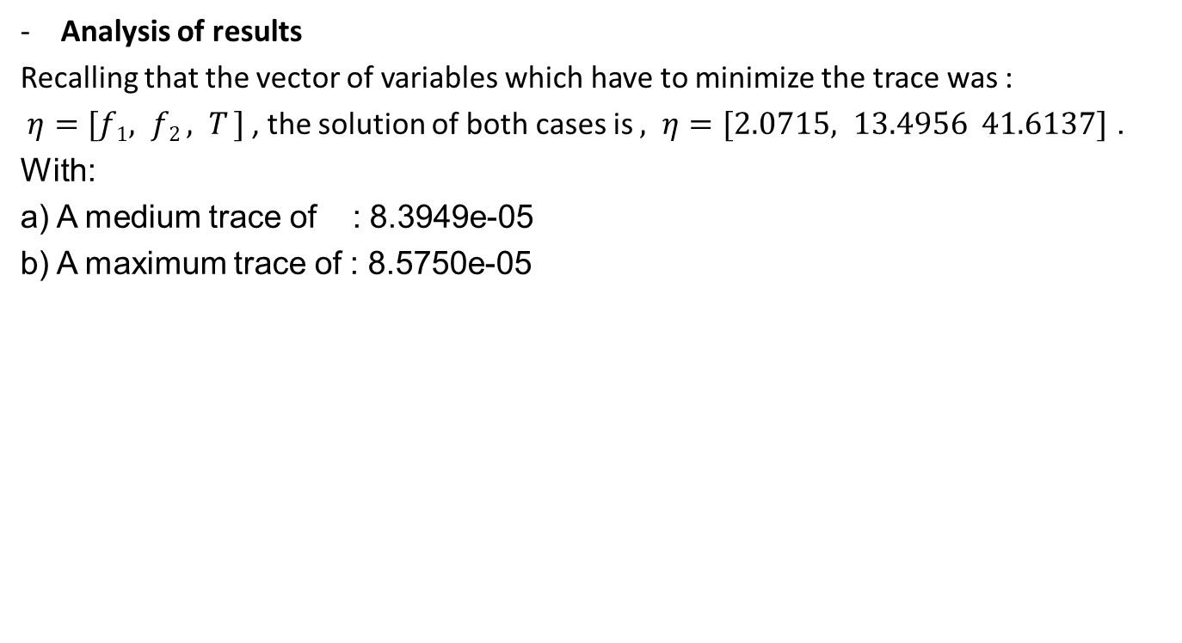
Task 2: Robust Experiment Design
Analysis of results
Recalling that the vector of variables which have to minimize the trace was :
$η=[f1, f2 , T ]$ , the solution of both cases is $, η=[2.0715, 13.4956 41.6137]$ .
With:
a) A medium trace of : 8.3949e-05
b) A maximum trace of : 8.5750e-05

Slide 23
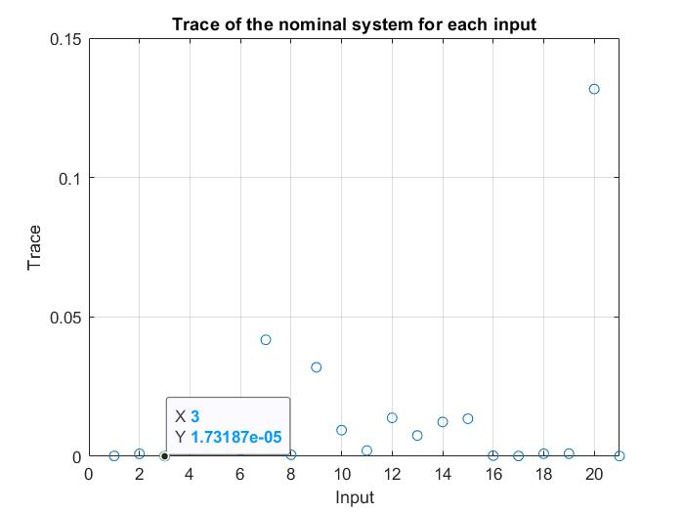
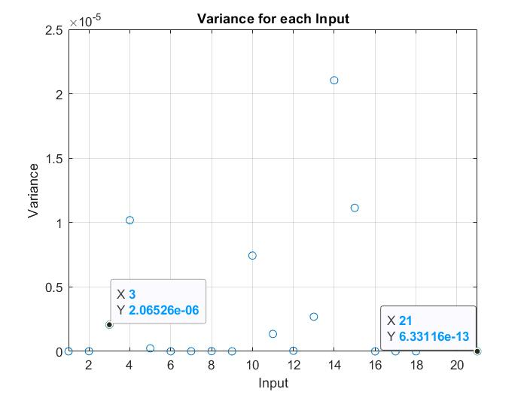
Task 2: Robust Experiment Design
In addition, the solution if applied to the nominal system gives a trace of 8.3695e-05, a huge improvement respect of the case of task 1 where it was 0.0257. Nevertheless it gives a fit to estimation data of [99;99]%
By the way, there is another input (not the identified solution) which gives the lower trace if applied to the nominal system (the 3rd).

Slide 24
Task 2: Robust Experiment Design
Output of the new identification procedure :
 | Xu | Xq | Mu | Mq | Xd | Md
VALUES | -0.1062 | 0.1192 | -5.987 | -2.645 | -10.16 | -451.65
VAR | 5.2479(e-10) | 5.9893(e-11) | 1.9901(e-06) | 1.10016(e-06) | 3.1950(e-10) | 8.0702(e-05)

Slide 25
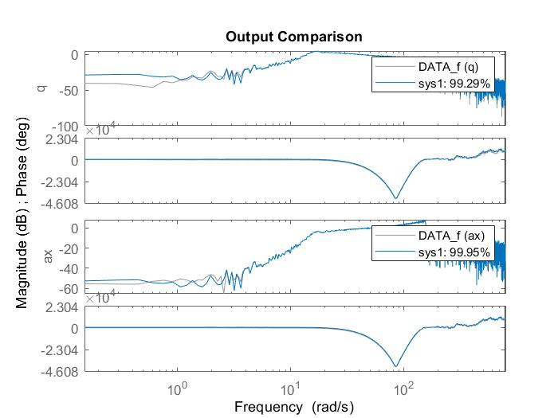
Task 2: Robust Experiment Design

Slide 26
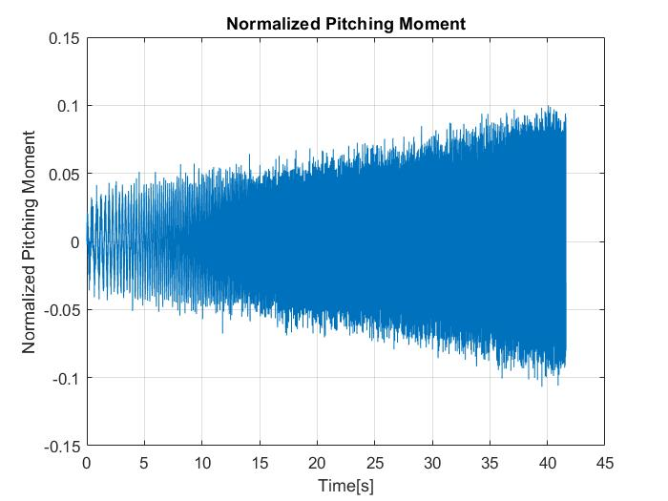
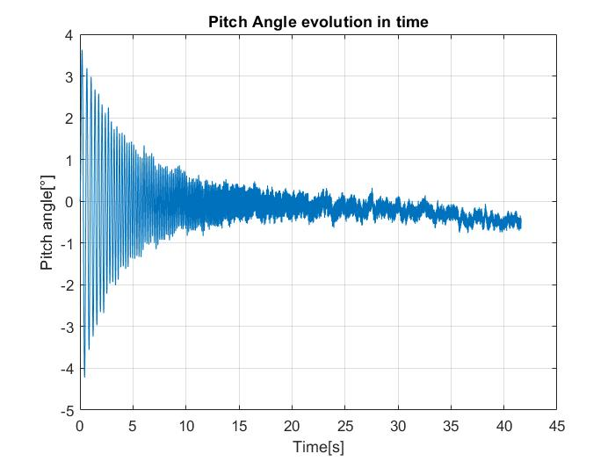
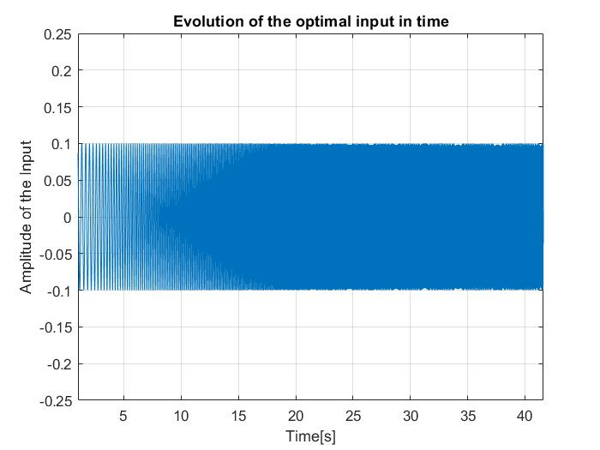
Task 2: Robust Experiment Design
Physical meaning (Checking if we are in
linear situation)

Slide 27
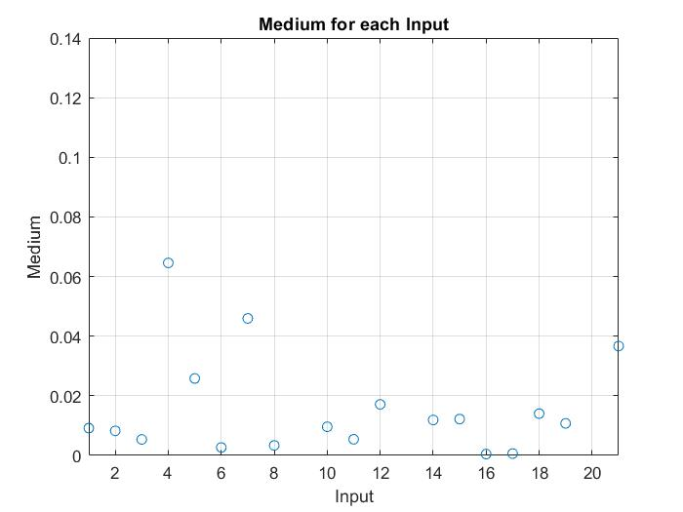
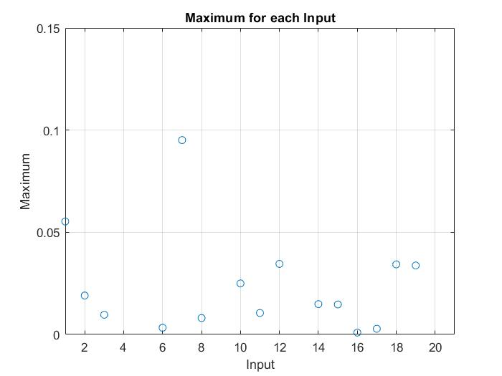
Task 2: Robust Experiment Design
Another simulation has been performed in order to search a more conservative robustness
Taken the 21 input found, we simulated them against 35 other random system.
20 of this systems have got the variances identified in the ask 1, while the other 15 have got uncertainty a bit higher.

Slide 28
Task 2: Robust Experiment Design
The solution changed,infact the previous optimal input showed a bad behaviour in the systems built considering an higher variance.
Infact the Simulation Time (T) showed to have a big impact in a problem with bigger uncertainty. ,
The new solution of both cases is , 𝜂 = [1.3241, 12.0000 58.2190] , with:
a) A medium trace of : 4.6134e-04
b) A maximum trace of : 9.1032e-04

Slide 29
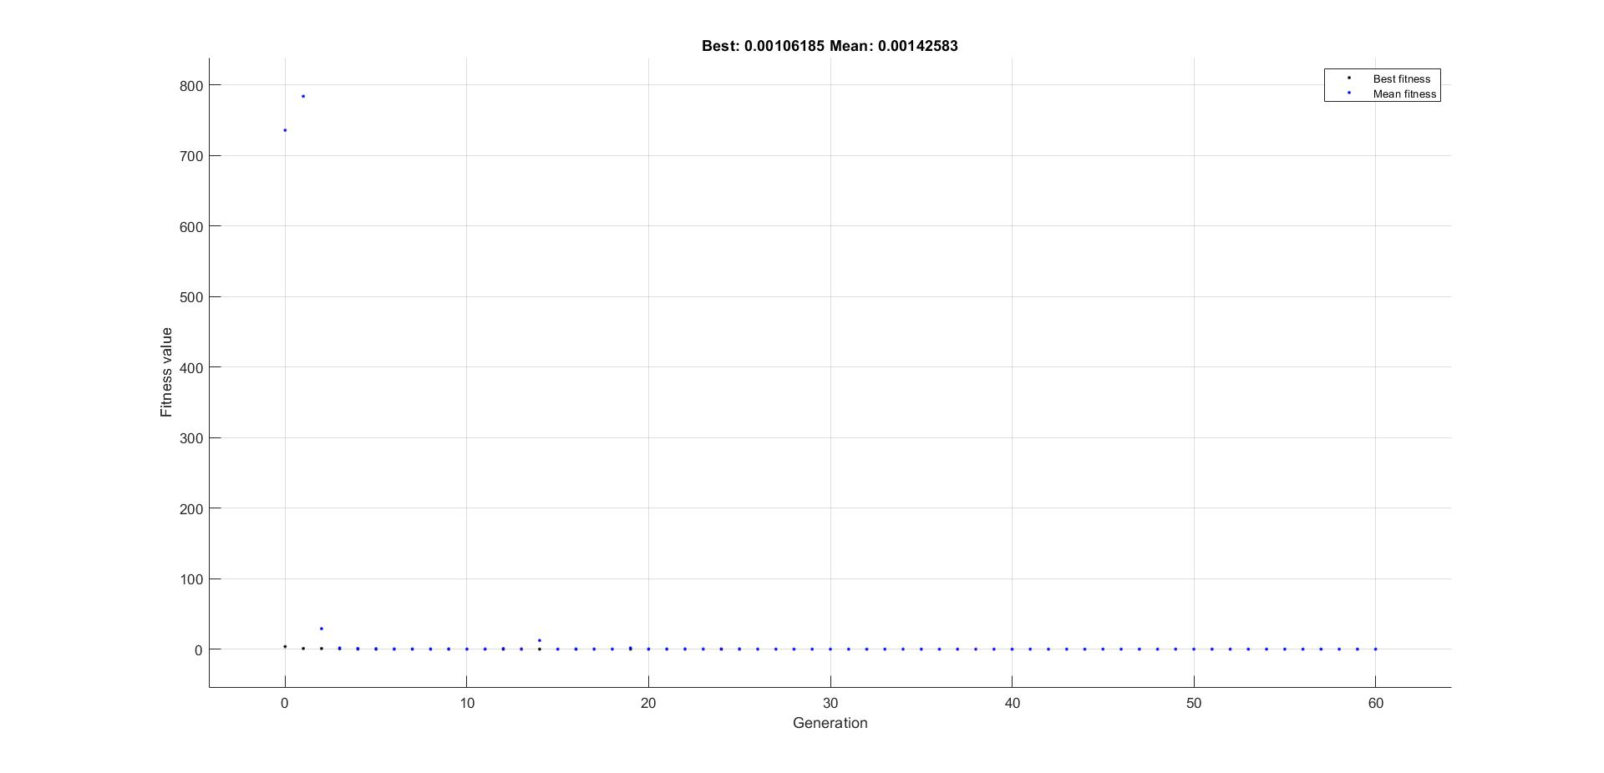
Task 2: Robust Experiment Design
Observations on ga on this task:

Slide 30
Thank you for your attention!

